Slide 1
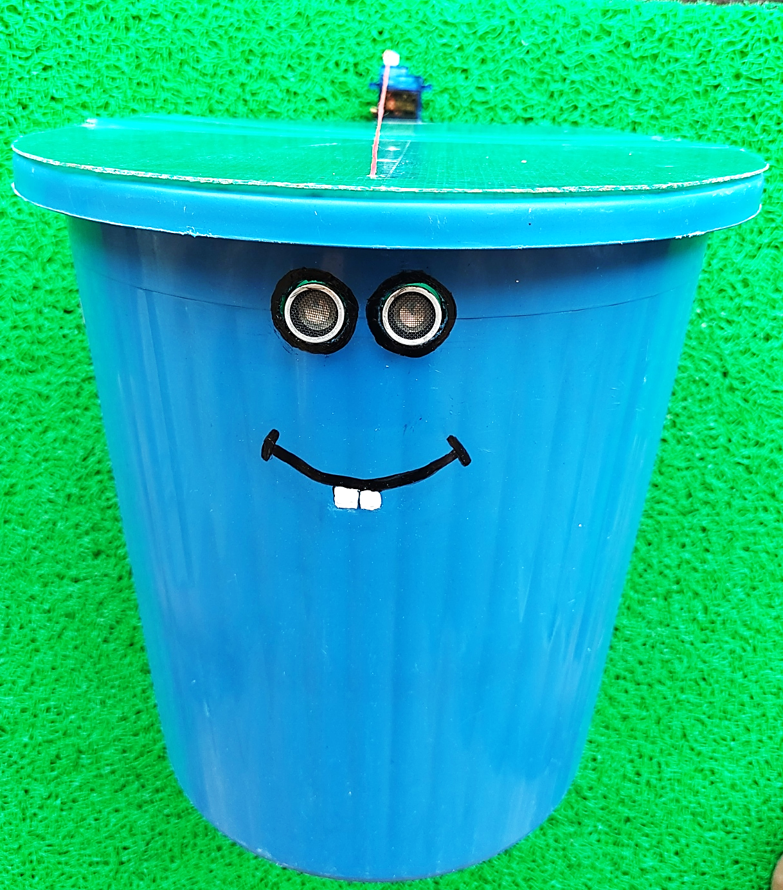
Smart
Dustbin

Slide 2
Introduction:
Smart Dustbin as its name represents it works smartly or we can say that it is an Automatic Dustbin. It works likewise Smart Things.
In this project, we will make a Smart Dustbin using Arduino, where the lid of the dustbin will automatically open when you approach with trash. It is a decent gadget to make your home clean and attractive

Slide 3
Tech Stack used:
SG90 Servo Motor
Arduino UNO
Jumper Wire
HC-SR04 Ultrasonic Sensor

Slide 4
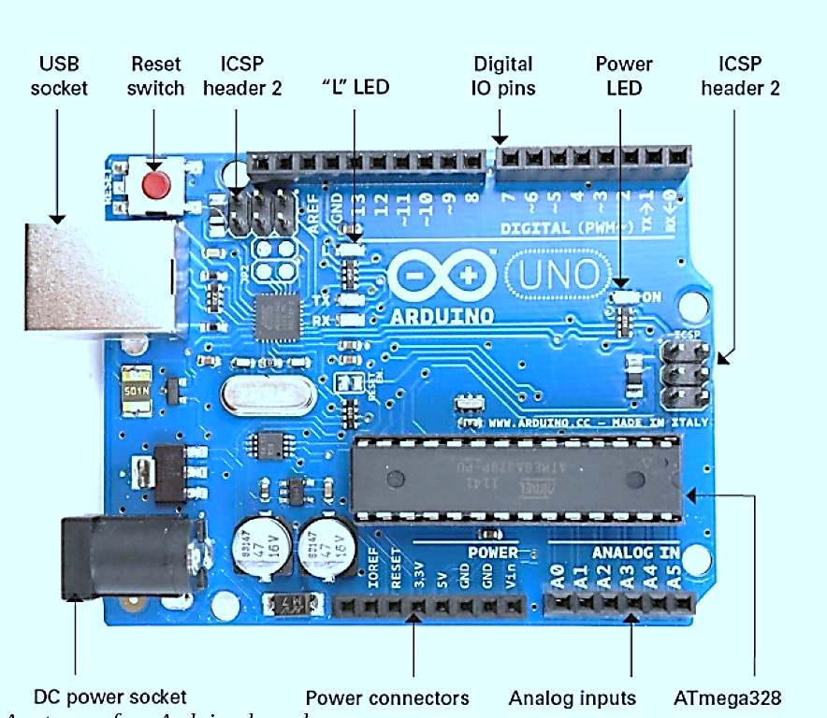
Arduino UNO
The Arduino Uno is an open-source microcontroller board based on the Microchip ATmega328P microcontroller. It has 14 digital input/output pins (of which 6 can be used as PWM outputs), 6 analog inputs, a 16 MHz quartz crystal, a USB connection, a power jack, an ICSP header and a reset button and is programmable with the Arduino IDE

Slide 5
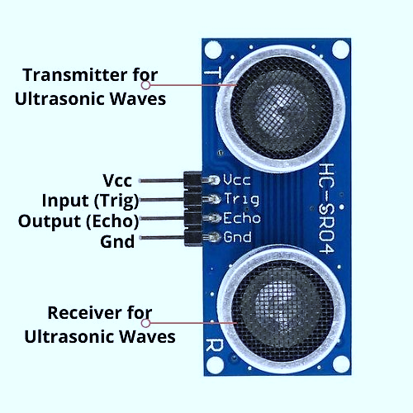
Hc-Sr04 Ultrasonic Sensor
The HC-SR04 ultrasonic distance sensor uses SONAR to determine distance to an object with stable reading high accuracy of 3mm.
The trig pin will send out the sonic burst which travels at the speed of sound. The soundwave will be bounced back once it interacts with a solid or liquid and will then be received in the echo pin. The distance between the sensor and the object will be calculated using the time of travel.

Slide 6
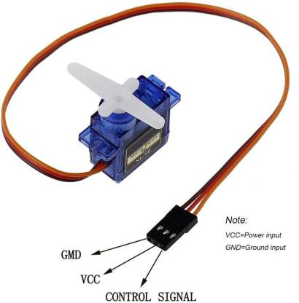
Sg90 Servo Motor
The TowerPro SG90 9g Mini Servo is a 180° rotation servo. It is a Digital Servo Motor that receives and processes PWM signal faster and better. It equips sophisticated internal circuitry that provides good torque, holding power.
We have to power the motor with +5V using the Red and Brown wire and send PWM signals to the Orange color wire. Hence we need something that could generate PWM signals to make this motor work

Slide 7
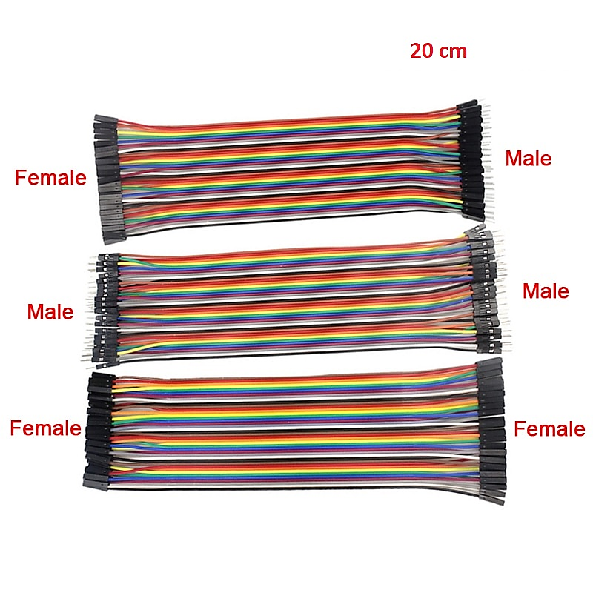
Jumper Wire
Jumper wires are simply wires that have connector pins at each end, allowing them to be used to connect two points to each other without soldering. Jumper wires are typically used with breadboards and other prototyping tools in order to make it easy to change a circuit as needed.

Slide 8
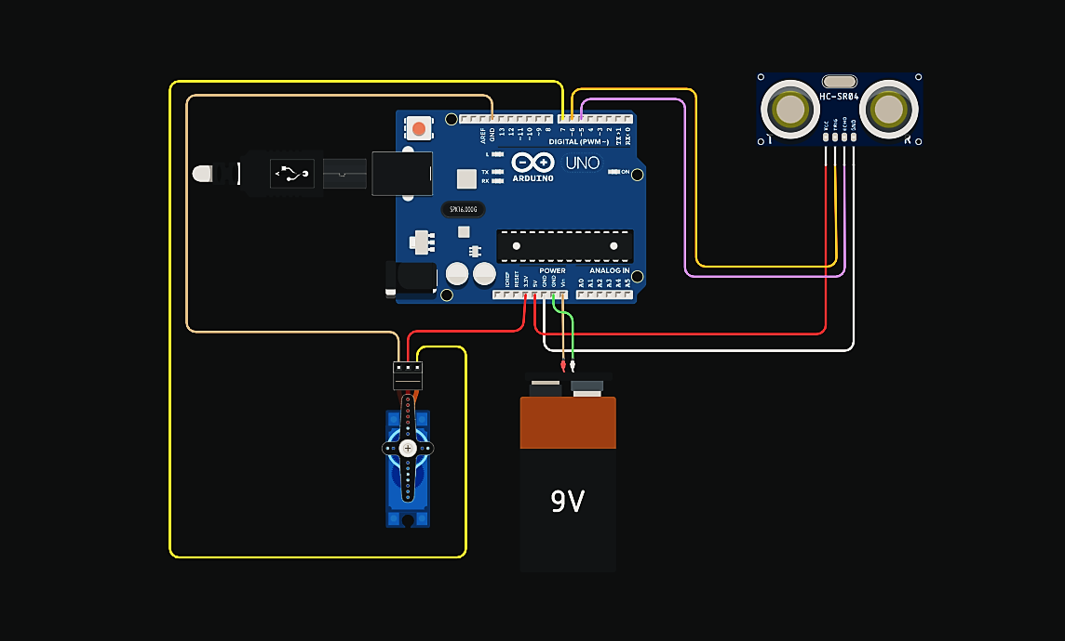
Circuit:

Slide 9
Working:
After setting up the Smart Dustbin and making all the necessary connections. The system is powered ON. Arduino keeps monitoring for any object near the Ultrasonic Sensor.
If the Ultrasonic Sensor detects any object like a hand for example, Arduino calculates its distance and if it less than a threshold value, Arduino will send the signal & activate the Servo Motor and with the support of the thread, it will list the lid open.
After certain provided time, the lid is automatically closed.

Slide 10
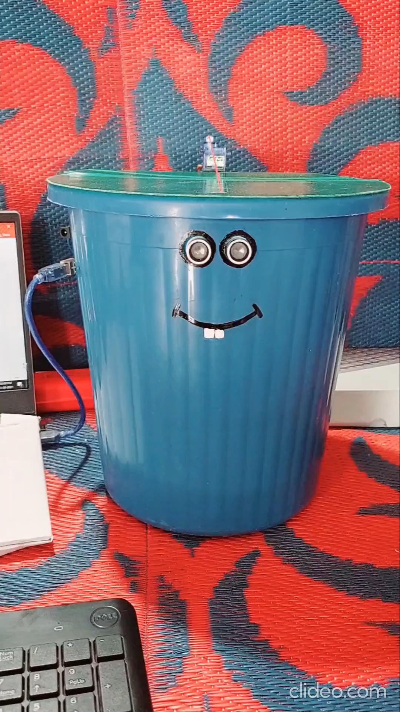
Output
Video:

Slide 11
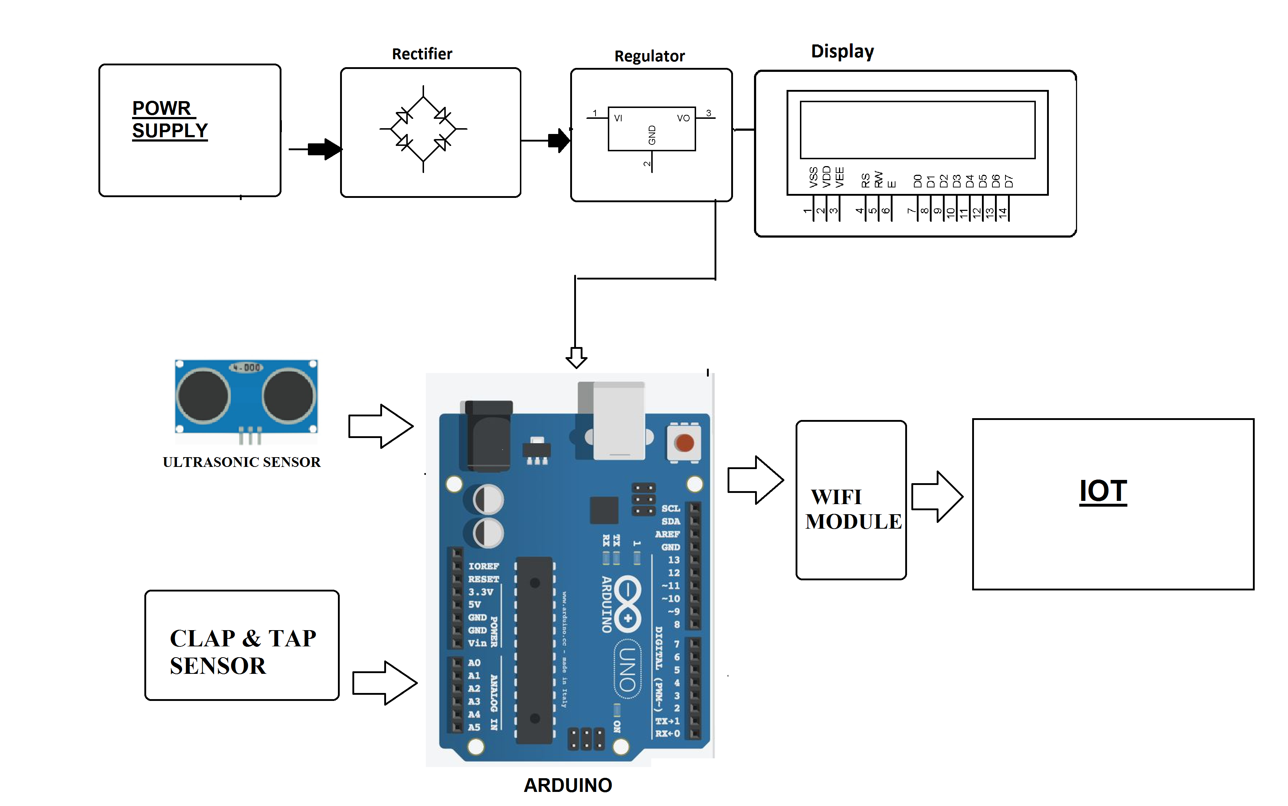
Future Scope:
With increase in population we have an increase in the garbage around urban areas. We extent this project to propose a smart dustbin that operates automatically using IOT and sensor based circuitry.
Our system consists of a sensor to detect human clap signal and on a clap of foot tap it opens automatically without anyone needing to press its lever. Also the dustbin consists of a level sensing ultrasonic sensor that constantly measures the level of garbage and automatically detects if it is about to fill up.
The dustbin now transmits this information over the web to signal the main garbage collector of the facility to empty the particular garbage bin.
This bin is of a vast usage in offices, homes and even in public places for garbage management. Thus we get a fully automated smart dustbin that allows for automated garbage cleaning.

Slide 12
Thank You

